Slide 1
ER-2
5

Slide 2
Contents
Entity Relationship(ER) diagram
ER Diagram Symbols

Slide 3
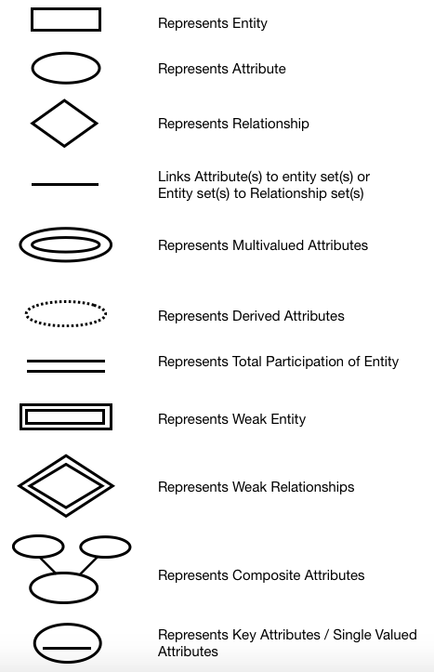
Notations

Slide 4
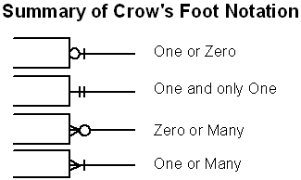
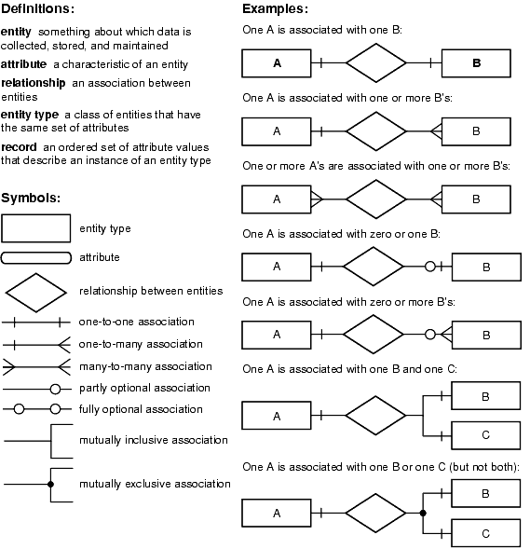
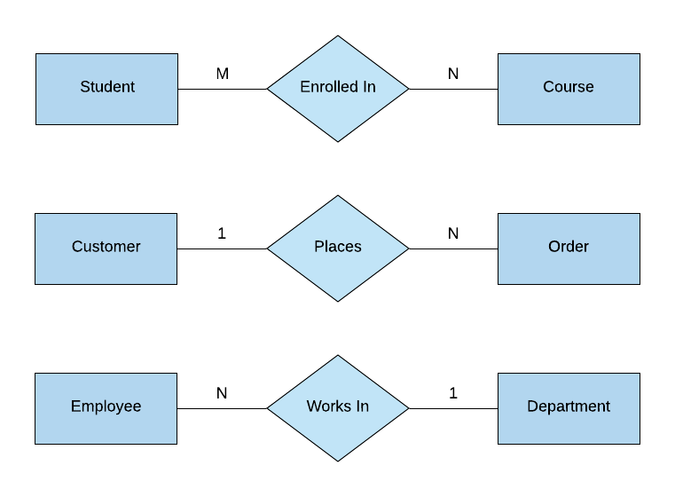
Notations

Slide 5
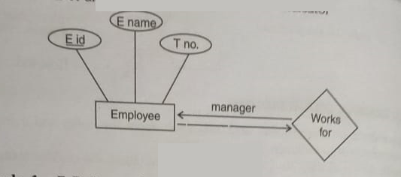
ER Diagram Example
E-R diagram for employee with role indicator.

Slide 6
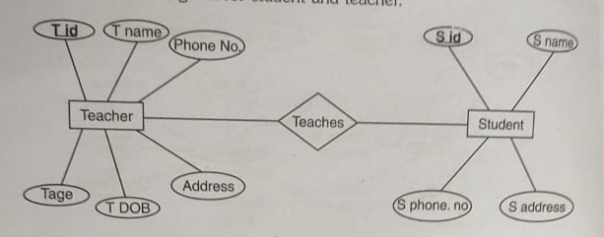
ER Diagram Example
E-R diagram for student and teacher.

Slide 7
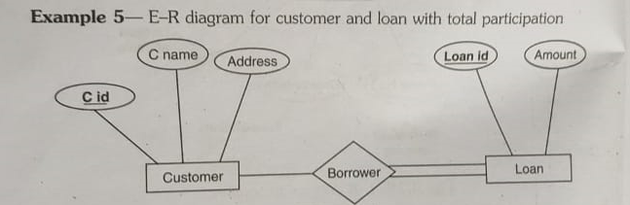
ER Diagram Example

Slide 8
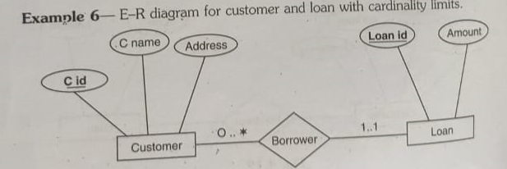
ER Diagram Example

Slide 9

How to Create an Entity Relationship Diagram (ERD)

Slide 10
Entity Relationship Diagram Example:
In a university, a Student enrolls in Courses.
A student must be assigned to at least one or more Courses.
Each course is taught by a single Professor.
To maintain instruction quality, a Professor can deliver only one course

Slide 11
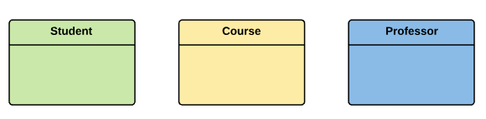
Step 1) Entity Identification
We have three entities
Student
Course
Professor

Slide 12
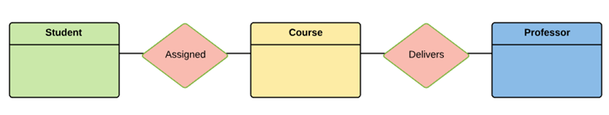
Step 2) Relationship Identification
We have the following two relationships
The student is assigned a course
Professor delivers a course

Slide 13
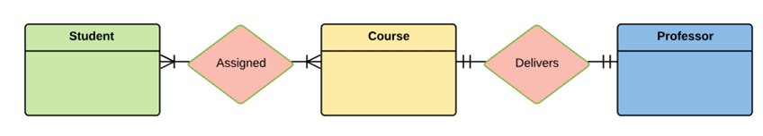
Step 3) Cardinality Identification
For them problem statement we know that,
A student can be assigned multiple courses
A Professor can deliver only one course

Slide 14
Step 4) Identify Attributes
You need to study the files, forms, reports, data currently maintained by the organization to identify attributes. You can also conduct interviews with various stakeholders to identify entities. Initially, it’s important to identify the attributes without mapping them to a particular entity.
Once, you have a list of Attributes, you need to map them to the identified entities. Ensure an attribute is to be paired with exactly one entity. If you think an attribute should belong to more than one entity, use a modifier to make it unique.
Once the mapping is done, identify the primary Keys. If a unique key is not readily available, create one.

Slide 15
Step 4) Identify Attributes Cont…
Entity | Primary Key | Attribute
Student | Student_ID | StudentName
Professor | Employee_ID | ProfessorName
Course | Course_ID | CourseName

Slide 16
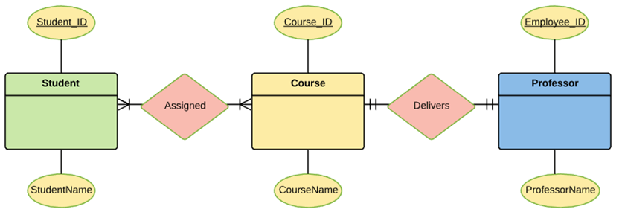
Step 4) Identify Attributes Cont…
For Course Entity, attributes could be Duration, Credits, Assignments, etc. For the sake of ease we have considered just one attribute.

Slide 17
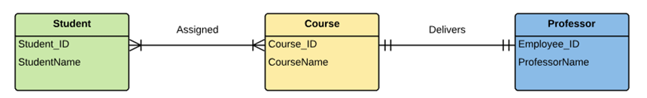
Step 5) Create the ERD Diagram

Slide 18
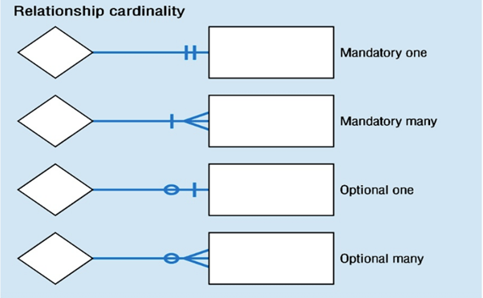
Relationship Cardinality

Slide 19
EasyShop Retail Application Case Study
Case Study 2
1. One supplier can provide many quotations.
2. For every item, there will be a separate quotation.
3. Many suppliers can quote for the same item.
4. Many items can be outward to the several retail outlets.
5. One employee works for only one retail outlet.
6. One retail outlet can have many employees.
7. Many customers can purchase items from several retail outlets.
8. One employee can nominate many dependents

Slide 20
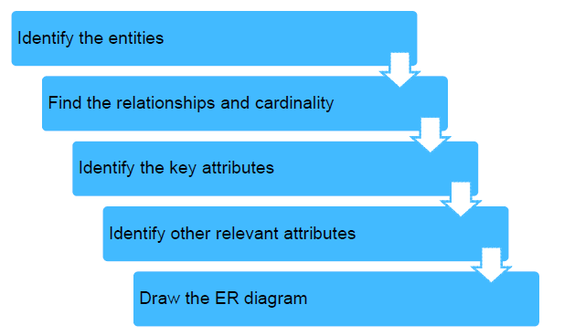
Developing ER Model

Slide 21
Steps in ER Modeling (1 of 5)
Step 1: Identify the entities
Supplier
Quotation
Item
RetailOutlet
Employee
Customer
Dependent

Slide 22


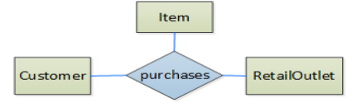
Steps in ER Modeling (2 of 5)

Slide 23
Steps in ER Modeling (3 of 5)
Step 3: Identify key attributes
Supplier supplierid
Quotation quotationid
Item itemcode
RetailOutlet retailoutletid
Employee empid
Customer customerid
Dependent

Slide 24
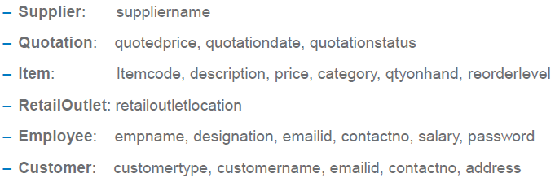
Steps in ER Modeling (4 of 5)
Step 4: Identify other relevant attributes

Slide 25
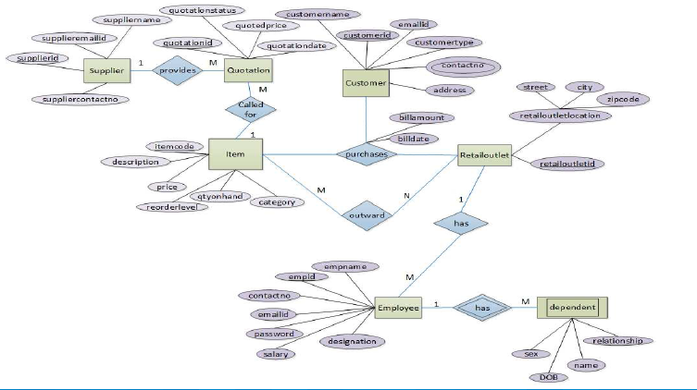
Steps in ER Modeling (5 of 5)

Slide 26
Questions
Construct an E-R diagram for Banking System
2. A university registrar’s office maintains data about the following entities: (a) courses, including number, title, credits, syllabus, and prerequisites; (b) course offerings, including course number, year, semester, section number, instructor(s), timings, and classroom; (c) students, including student-id, name, and program; and (d) instructors, including identification number, name, department, and title. Further, the enrollment of students in courses and grades awarded to students in each course they are enrolled for must be appropriately modeled. Construct an E-R diagram for the registrar’s office.
Document all assumptions that you make about the mapping constraints.

Slide 27
Sr.NO. | Strong Entity | Weak Entity
1. | Strong entity always has a primary key. | While a weak entity has a partial discriminator key.
2. | Strong entity is not dependent on any other entity. | Weak entity depends on strong entity.
3. | Strong entity is represented by a single rectangle. | Weak entity is represented by a double rectangle.
4. | Two strong entity’s relationship is represented by a single diamond. | While the relation between one strong and one weak entity is represented by a double diamond.
5. | Strong entities have either total participation or not. | While weak entity always has total participation.

Slide 28


